Slide 1




Text here
2025 - Secondary School
Notes:
Introduction:
Hi, my name is [insert] and I work at The Salvation Army in [insert]. My role is [provide description].
Thank you for inviting me to speak today.
Today I’m going to be speaking with you for about 10 – 15mins about the work of The Salvation Army, our support locally in [region] and how your school is supporting us through our Christmas Appeal.

Slide 2

Notes:
First, I would like to acknowledge the Traditional owners of the land we meet [land] and pay respect to Elders past, present and future.

Slide 3



For over 140 years, The Salvation Army has been giving
hope where it’s needed most.
Notes:
*If a small audience, you may like to ask ‘who has heard of The Salvos before’ or ‘where have you seen our Shield before?” follow up by asking students if they know what The Salvos do and then positively encourage and debrief.
We are a leading social service provider in Australia and the largest provider of homelessness services. We have locations all across Australia (and internationally) and provide a number of care services, often specific to the needs of the local community where we are present.

Slide 4
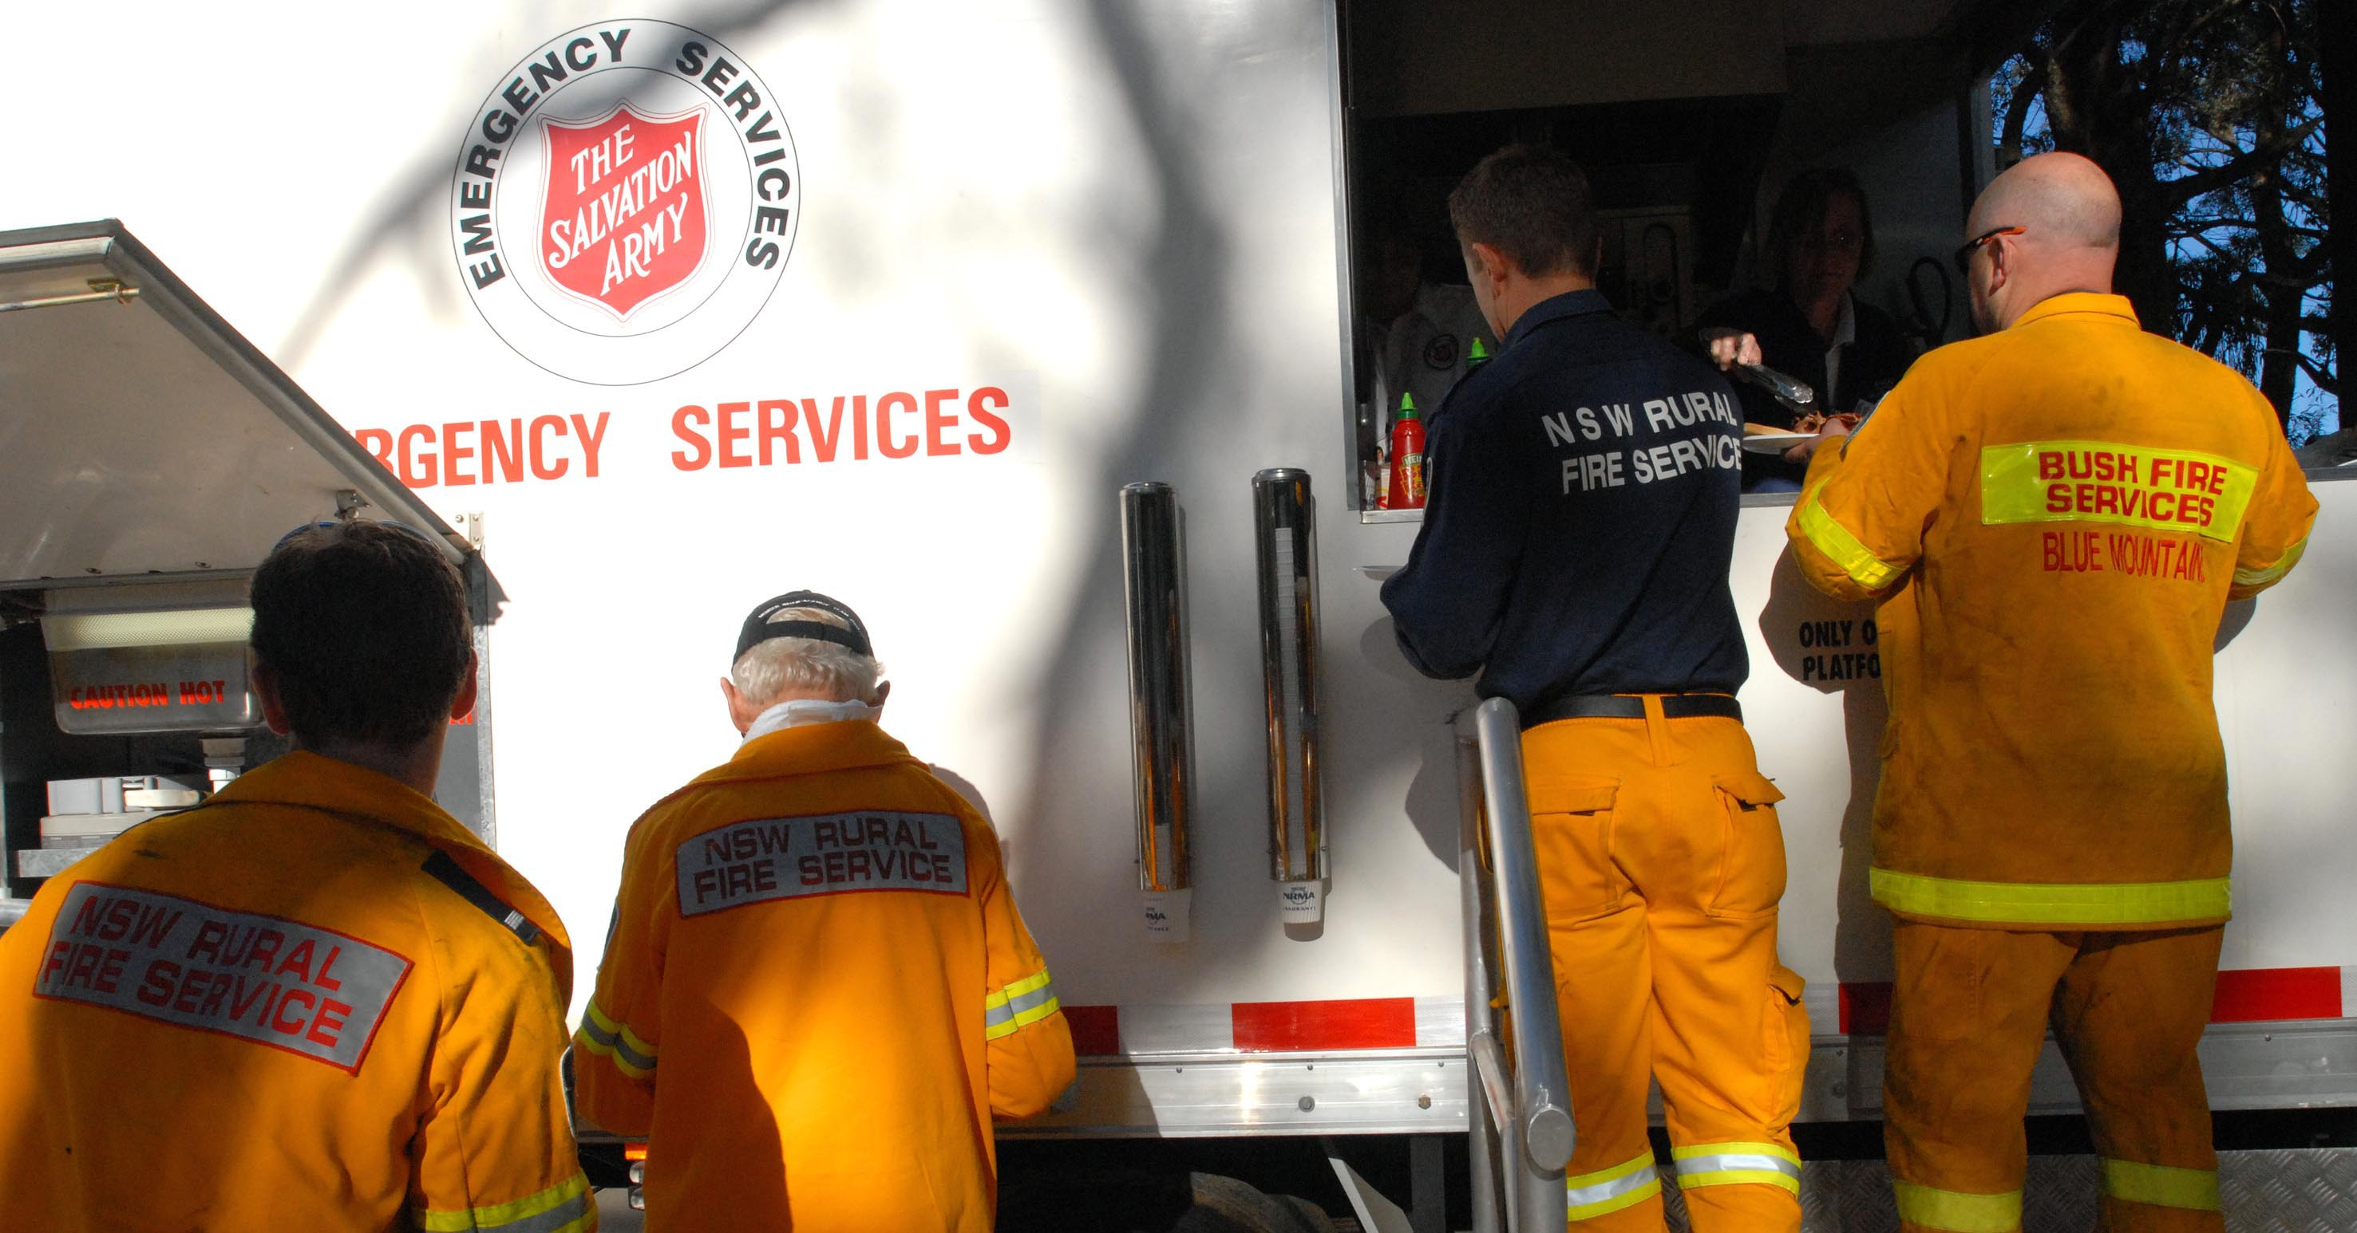
What we do:
Community services
Homelessness services
Youth services
Family & domestic violence services
Addiction recovery programs
Chaplaincy
Emergency & disaster response
Notes:
Many people know about The Salvos because of our Salvos Stores, or our support to people experiencing homelessness. We also run:
community services, youth services, family and domestic violence services, addiction recovery programs, chaplaincy, emergency and disaster response services
Salvos Stores help us generate the funds we need to provide the support that we do.

Slide 5
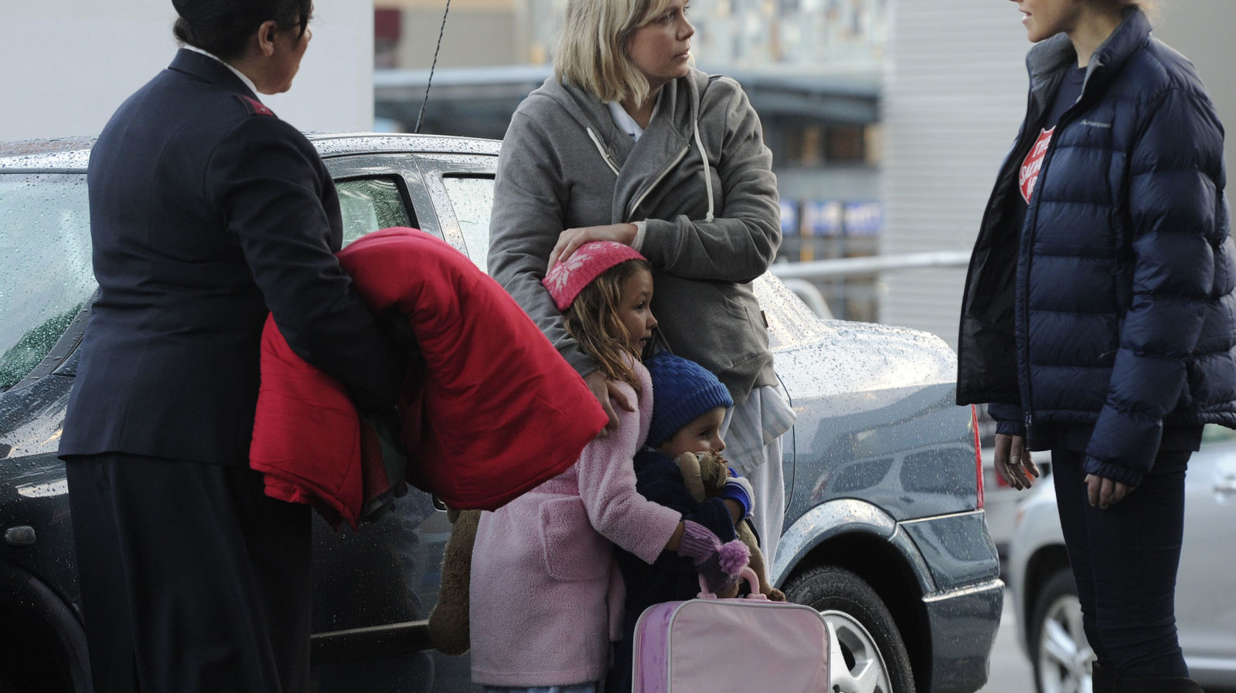
Last year, we provided…
Over 1.76+ million sessions of care
Over 1.1 million nights of accommodation
Supported more than 27,000 people seeking employment
Notes:
In the last year…
*1.67mil sessions of care provided
Over 1.2 million nights of accommodation
Supported 36000people seeking employment
Assisted more than 10,000 people experiencing domestic and family violence

Slide 6


More than ever, Australians are calling on The Salvation Army for support.

Slide 7
How does the Salvos help our local community?
Notes:
Here, talk sensitively to the services that your Mission Expression provides. You could list your services, go through your weekly schedule – and share what you do to support your local community
***Include appropriate photos where possible!

Slide 8

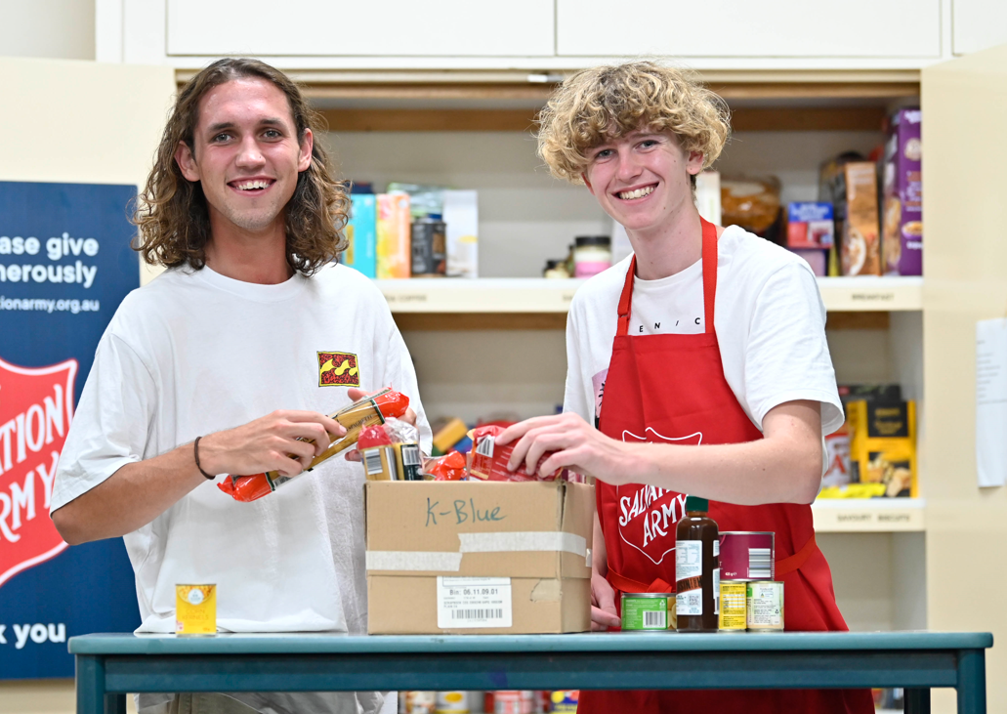
The Salvos believe in good for your Christmas – and you can too…
Notes:
When people are struggling to get by, food can be one of the first things to go. More than 50% of people who seek our support are skipping meals each day* No one should go hungry and everyone deserves to experience the magic of the holidays.
Whether it’s enabling an isolated person a Christmas meal, ensuring families can access some special ingredients for a holiday dinner, or providing a gift for someone in need, your donation will help people feel valued.
(source:https://www.salvationarmy.org.au/about-us/news-and-stories/media-newsroom/surge-in-australians-sinking-into-extreme-poverty-amid-cost-of-living-crisis-salvation-army-research-reveals/)

Slide 9

We need your help.
Every donation counts. You can help us ensure no one is left in need.
Notes:
This year, your school is supporting our Christmas Appeal. You're invited to donate (clothes/toys/money) that we will distribute to those most in need within our local community.

Slide 10
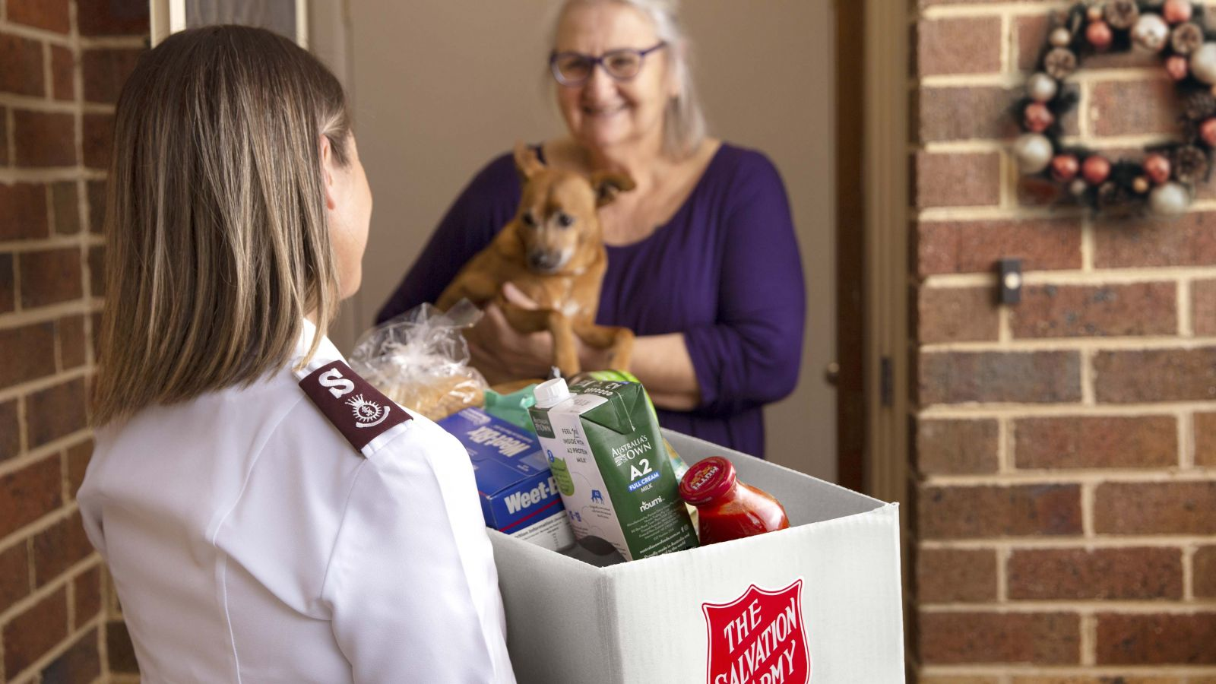
What to donate?
Notes:
Give example for [Food/Gifts].
Provide guidance on giving such as…
• Please make sure all items being donated are new/unused unopened
• Please ensure items have long expiry dates and are non-perishable (Ask a student to define ‘non-perishable’)
• Consider providing food that will suit families with young children, people with allergies, the elderly and new Australians

Slide 11
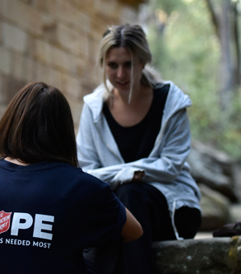
We’re here for you
The Salvation Army is a place where you can get help and give hope to others.
Notes:
We’re here for you.
The Salvation Army is a place where you can get help and give hope to others.
We believe in good.
You can look us up online at salvationarmy.org.au and on Facebook.
Add information here about any local initiatives for young people and school students, such as volunteering (appropriate to the context of the school).

Slide 12

Be the hope this Christmas.
Your gift really does make a difference.
Thank you for your generosity.
Notes:
Your gift really does make a difference.
For items: “We will collect your donated items and make sure they give hope where it’s needed most.”
*Any questions?
*Thank the school sincerely

